Slide 2
Una Europa University Partners
Freie Universität Berlin
Università di Bologna
University College Dublin
University of Edinburgh
Helsingin Yliopisto
Universiteit Leiden
Uniwersytet Jagielloński
w Krakowie
KU Leuven
Universidad Complutense
de Madrid
Université Paris 1
Panthéon-Sorbonne
Universität Zürich
UNA Europa presentation

Slide 3
The External Economic Action of the European Union and the Sustainable Development Goals
Filippo Fontanelli – University of Edinburgh – filippo.fontanelli@ed.ac.uk
University of Bologna
3 May – 25 May
3 May 2023
The basic coordinates

Slide 4
Outline of the module (in progress)
The course’s basic coordinates
  Trade law, investment law and sustainable development: basic notions
  EU competences and policies in trade and investment law
Trade/investment obligations and non-trade values: the return of unilateralism
  The backlash against investor-State arbitration.
  The backlash against trade liberalisation
  Reform proposals for the global investment and trade regimes
  An overview of re-nationalisation trends in trade an investment (US, EU, UK, China)
    Anti-coercion
    Anti-circumvention
    Retaliate against non-MPIA
    Steel row, now sustainable
EU’s external economic action to raise standards abroad
  Free trade agreements and non-economic standards
    Conflict mineral regulation (sort of like diamonds)
    2022 commitment to green trade partnership
    Deforestation MERCOSUR
  Zoom-in: EU dispute with Korea on labour rights
  Zoom-in: level playing field and sustainable development in the Trade and Cooperation Agreement between the EU and the UK
    Mirror clauses
The Carbon Border Adjustment Mechanism
  Overview and assessment of the scheme
  Compatibility with WTO law (China’s complaint at WTO)
  Bonus: carbon removal
Energy (trade)
  EU Net Zero Industry Act and support to renewable energy industry (with assessment of WTO compatibility)
  Reaction to comparable foreign plans (US IRA)
  Zoom-in: biofuels and e-fuels
Energy (investments)
  Foreign investment protection and the fossil fuels industry
  Foreign investment protection and the nuclear energy industry
  Foreign investment protection and the renewable energy industry
  The Energy Charter Treaty, its reform attempts and the withdrawal of EU MS
Controlling trade and investment inbound and outbound flows
  Export restrictions and export controls (including coordinated action with US)
  Critical Raw Materials Act
  EU investment screening
Improving supply chains’ sustainability
  Friend-shoring and sustainable value chains
  Global supply chain due diligence proposal
  EU Guidance to Combat Forced Labor in Supply Chains
  Responsible forestry proposal (trade in forest-risk commodities)
  WTO law-compatibility of these schemes
Promotion of other social interests
  Non-paper of the Commission services 2017 TSD chatpers
  Gender balance in corporate governance in FTAs
  Protection of indigenous peoples’ rights
UNA Europa presentation

Slide 5

Presentations?
For last session, or thematic input into sessions 2 to 8.
Just drop me an email at filippo.fontanelli@ed.ac.uk

Slide 6

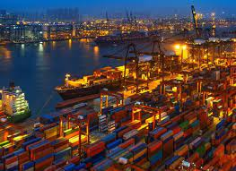
The basic coordinates of the module
EU external economic action: actors and processes
Trade law, investment law and sustainable development
UNA Europa presentation

Slide 7
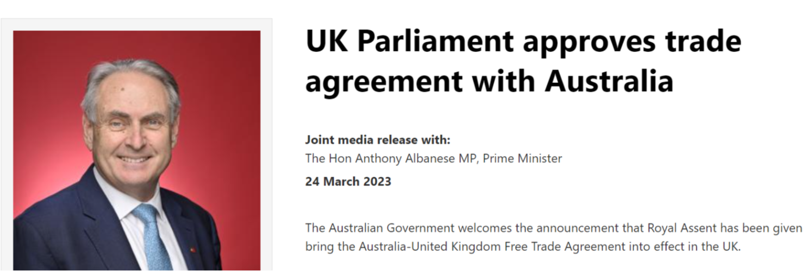
Trade, what is going on?
UNA Europa presentation

Slide 8
Investment, what is going on?
UNA Europa presentation

Slide 9


Slide 10
Trade laws and institutions
World Trade Organization
Trade agreements

Slide 11
Why should trade be fre-er?

Slide 12
PRINCIPLES
Bound tariffs
Non-discrimination
  National treatment
  Most-favoured nation
No quantitative restrictions
Special and differential treatment
UNA Europa presentation

Slide 13
General Exceptions
UNA Europa presentation

Slide 14
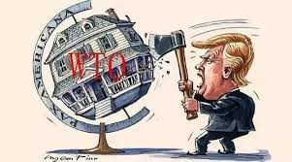
Dispute settlement
Binding reports
Panels and Appellate Body
No retrospective remedies
Authorised retaliation
AB crisis - MPIA
UNA Europa presentation

Slide 15
Free trade agreements
Exception to non-discrimination (tolerated by WTO)
  Free trade areas – Customs Unions
  Deepening WTO commitments
  Adding non-WTO commitments

Slide 16
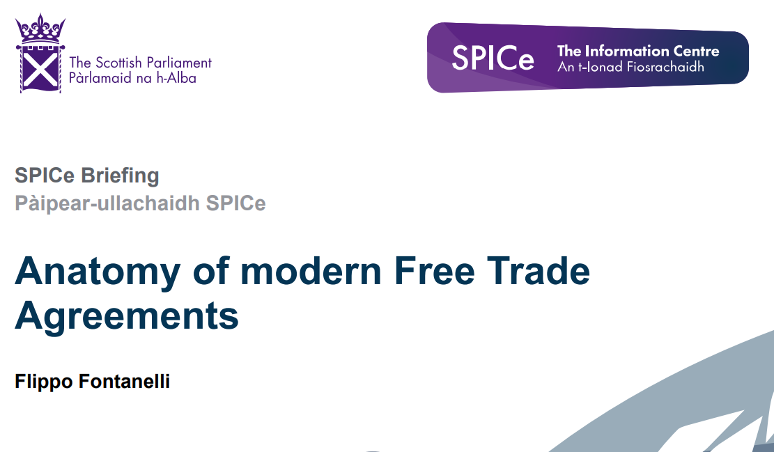

Slide 17
International investment protection
Instruments of protection
Enforcement through arbitration

Slide 18
Why should investments be protected?

Slide 19

PRINCIPLES
Non-discrimination
  National treatment
  Most-favoured nation
Compensated expropriation
Fair and equitable treatment
Full protection and security
UNA Europa presentation

Slide 20

Dispute settlement
Binding arbitration
Investors claimants
Monetary awards
Enforcement
Annulment/setting aside
UNA Europa presentation

Slide 22

ACTORS
Commission
Council of European Union
European Parliament
Court of Justice of the EU
Member States
UNA Europa presentation

Slide 23
Commission
Initiates policies and laws
Negotiates FTAs
External representation (art 17 TEU)
Implements laws and policies
Enforce against MS and III countries
Communications: see 2006 on Global Europe
UNA Europa presentation

Slide 24
Council
Policy-making
Trade Policy Committee
Co-legislator
Ratifies FTAs
        Authorises opening of negotiations
        Issues directives for FTA negotiations
UNA Europa presentation

Slide 25
Parliament
Increased role after Lisbon
(approves commissioners)
International Trade Committee
Adopts resolution on negotiating platform
        Consents to FTAs
UNA Europa presentation

Slide 26
FTA-making process
The negotiation procedure:
The Commission submits recommendations to the Council on each specific agreement. If the agreement relates mostly to foreign and security policy, the High Representative for Foreign Affairs and Security Policy submits the recommendations.
The Council then adopts a decision authorising the opening of negotiations. It usually also adopts negotiating directives which set out the general objectives to be achieved during negotiations.
The Commission represents the EU during negotiations, except where the agreement relates to foreign and security policy, when the EU is represented by the high representative. Negotiations between the EU and the non-EU parties or international organisation usually take place in different 'rounds'.
For some types of agreement, the Council appoints a special committee which consults with the Commission throughout negotiations. The Commission regularly reports back to this committee and the European Parliament on the progress of negotiations.
The Council can adopt revised or new negotiating directives at any time during negotiations. This would be done to change the negotiating position, or when the negotiator (the Commission) wants to deviate from the previously agreed position.
The Council and the Commission are jointly responsible for checking that the agreements negotiated are compatible with internal EU policies and rules.
At the end of negotiations, the Council adopts a decision on the signature of the agreement. In some cases, the Council also takes a decision on the provisional application of an agreement. These decisions are taken on the basis of a Commission proposal.
The Council also adopts the final decision to conclude the agreement. This can only be done once the European Parliament has given its consent (for association agreements and for areas subject to either the ordinary legislative procedure or consent procedure) and it has been ratified by all EU member states. In other areas, except agreements relating to common foreign and security policy, the European Parliament has to be consulted.
UNA Europa presentation

Slide 27
Domestic rules with trade effects
Product and process requirements
Domestic regulations

Slide 28
@una_europa
#Una_Europa
Thanks!

